Slide 1
Terra-Table
Topographical Terrain Table for D&D and Other Tabletop Games
Quinton Woodward, Luke Sferrella, & Connor Hyde | 2023 CEAS Expo

Slide 2
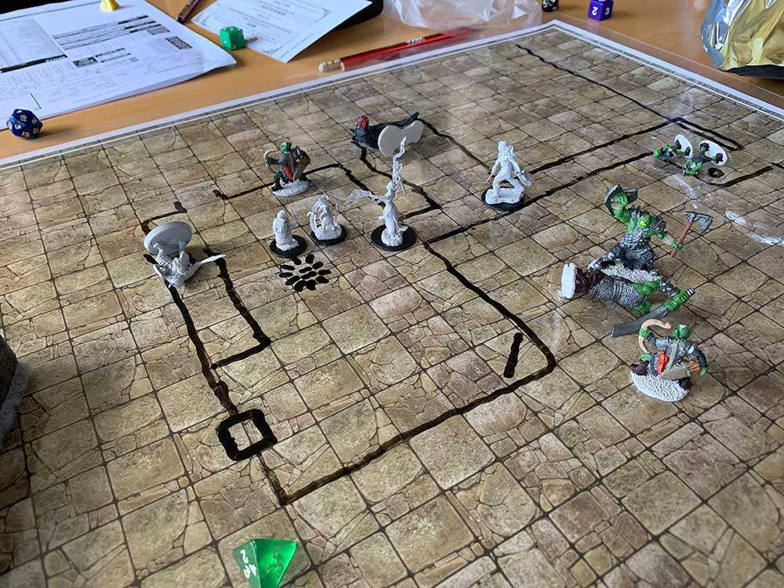

Dungeons and dragons
2023 CEAS EXPO
Tabletop role playing game
Players often use mini-figures to represent their character
Grid like “Battle Map” used for part of gameplay

Slide 3
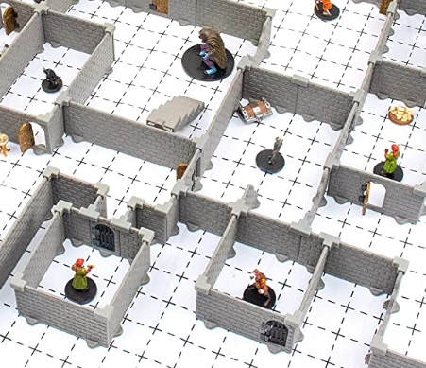
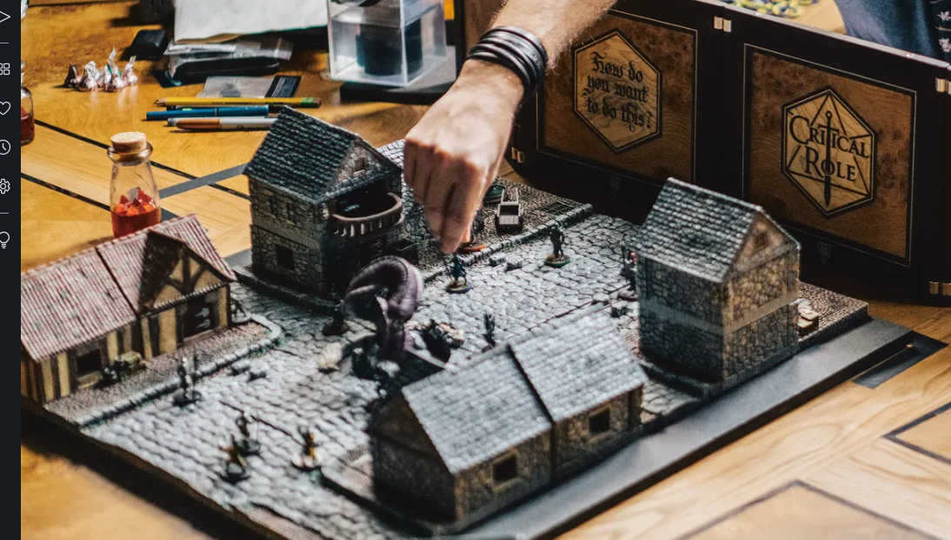
Low Tech solutions
2023 CEAS EXPO
Modular kits with blocks/walls
3D printing terrain
Elaborate dioramas
Take time, effort, and only have one configuration

Slide 4
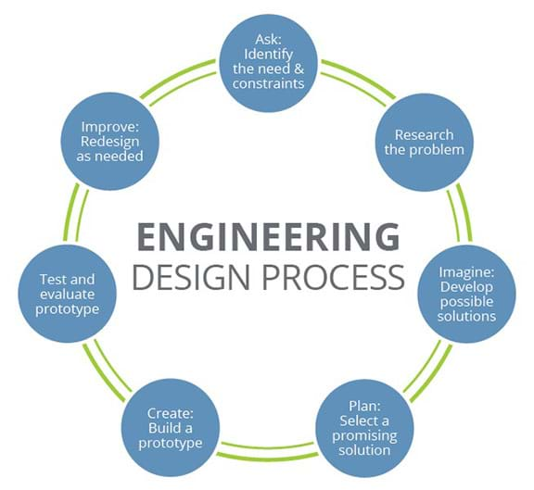
Project Objectives
2023 CEAS EXPO
Key Success Factors
Project outline and road-mapping
Task on-time delivery
Budget/Expense tracking
Advisor check-ins
Functional Prototype
Develop a one-of-a-kind method for rendering 3D landscapes
Use engineering principles to design and manufacture a prototype
Integrate mechanical structure with a functional user interface

Slide 5
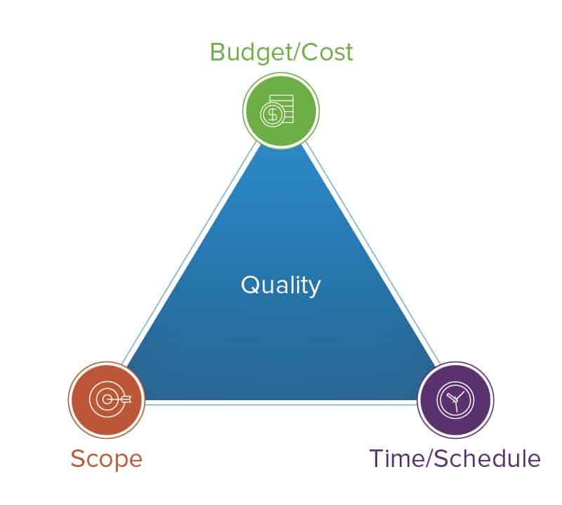
Constraints
2023 CEAS EXPO
Economic
Prototyping Cost
Independent Funding
Strict Budgeting
Manufacturing
Minimal 3rd Party Usage
Rapid Prototyping Cost
Team Member Build Hours
Specifications
Consumer Product Safety Commission
ASTM F963 Toy Safety
Sustainability
Component Quantity
Material Selection
Purchased vs. Manufactured Parts
Health/Safety
Consumer Product Restrictions
User Interface Safety
Toxic Chemical Exposure
Environmental
Manufacturing Waste Management
Ethical
“Do No Harm” Engineering Principles
Copywrite/Patent Violations

Slide 6

Standards and Codes
2023 CEAS EXPO
Consumer standards for safety, construction, and testing:
Consumer Product Safety Commission
Title 16 CFR Chapter II Subchapter B: Consumer Product Safety Act Regulations
Part 1250 – Requirements for tabletop toy acoustic emssions
ASTM F963-17
Pinch Points
Mechanical Entrapment
Testing procedures
Testing equipment
Material Property Codes
ASTM B221 – Material parameters for load bearing parts

Slide 7
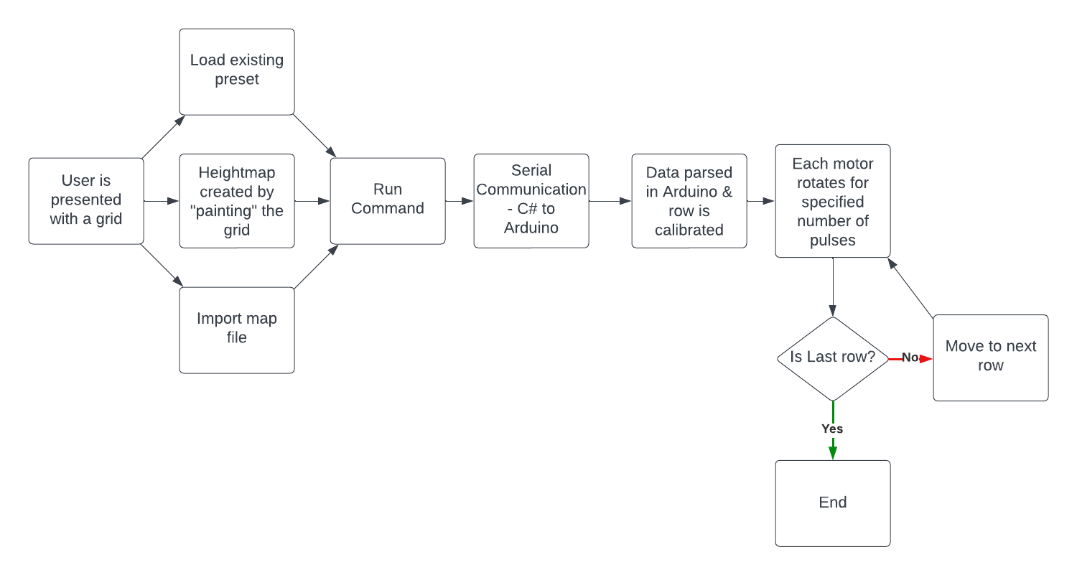
Code Flowchart

Slide 8
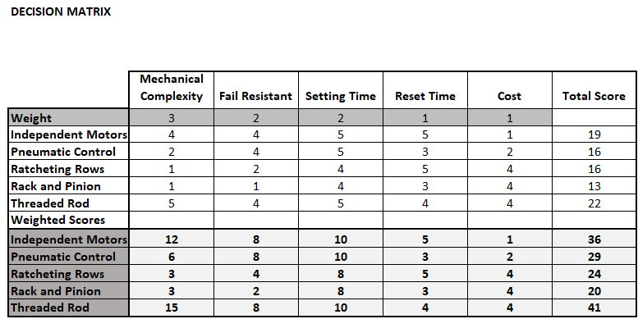
Design Process
2023 CEAS EXPO

Slide 9
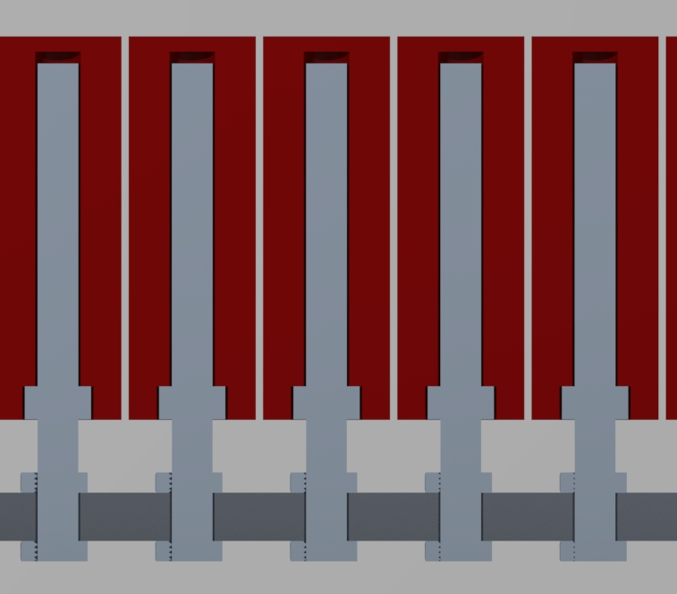
Design Concept
2023 CEAS EXPO
8mm Threaded Rod
3D Printed Block
Captive Hex Nut
Aluminum Plate

Slide 10
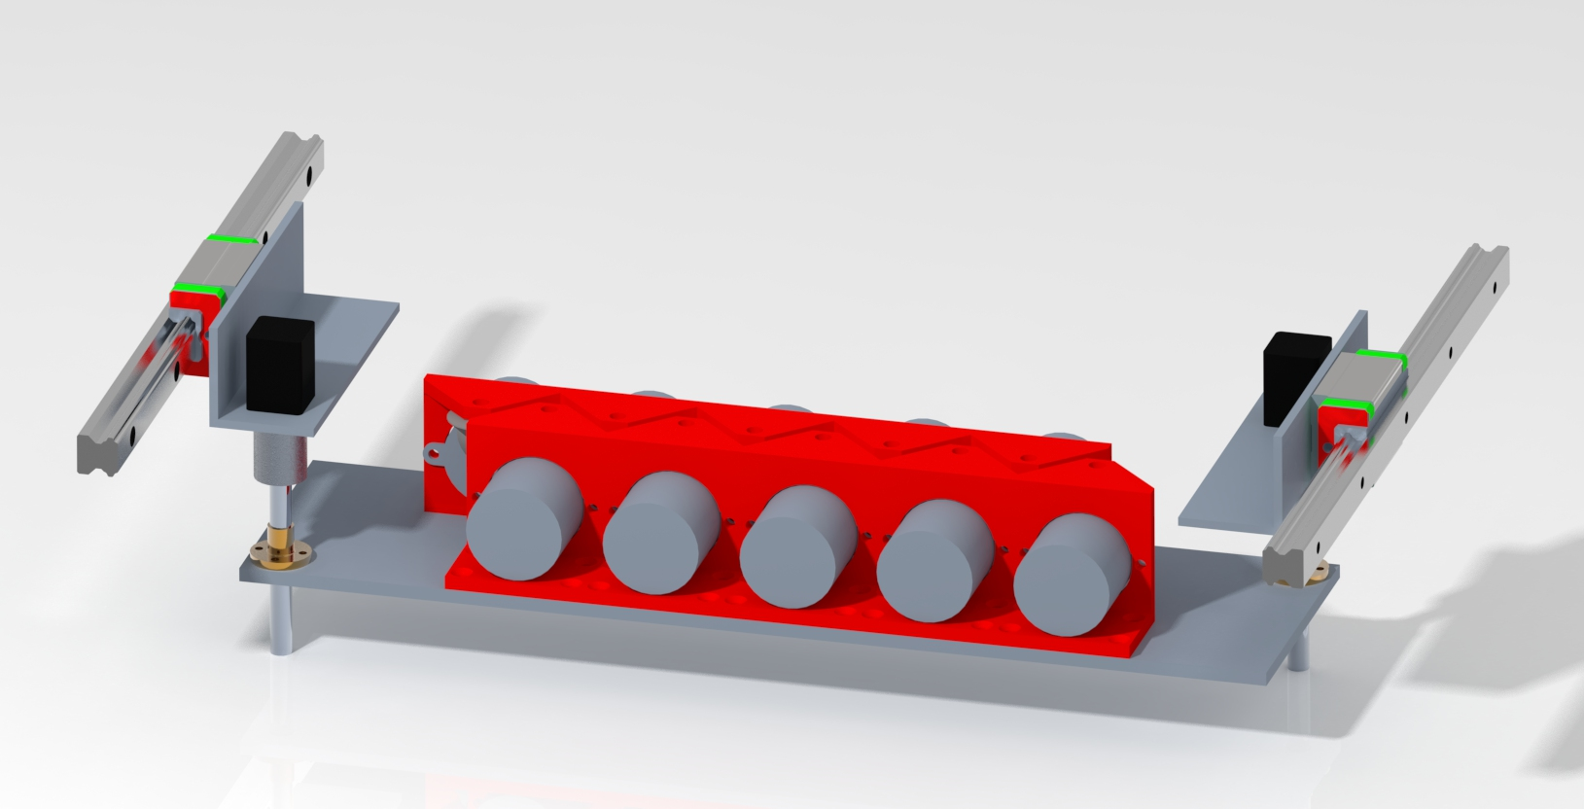
Motor Gantry
2023 CEAS EXPO
10 motors on 1/4” aluminum plate
3D printed mounting brackets also will hold sockets for turning threaded rods
Plate can be raised and lowered by two motors with lead screws to engage with each row of threaded rods
Entire system rides on linear rails

Slide 11
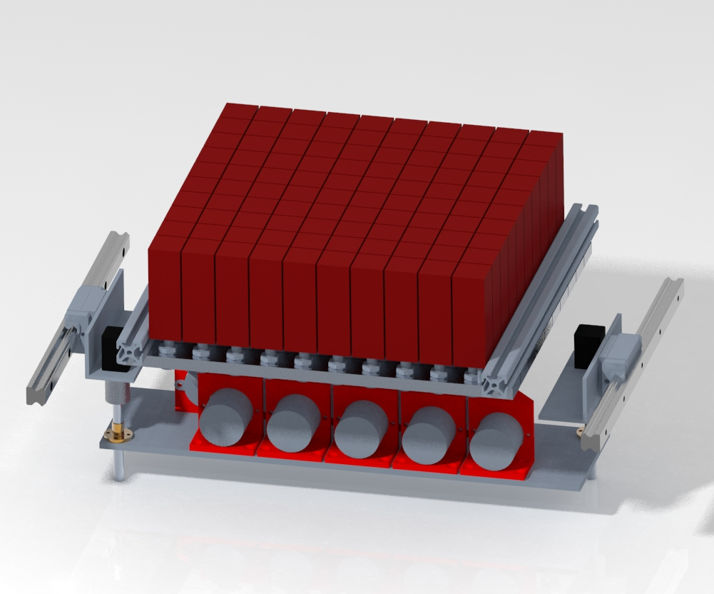
Finalized design
2023 CEAS EXPO
3D printed blocks mounted to threaded rods
10 motors on a gantry moves row by row to set each block to designated position
Applied mechanical principles
Deflection of gantry and load bearing members and strength of materials
Motor torque output and power requirements
Electrical circuit design

Slide 12
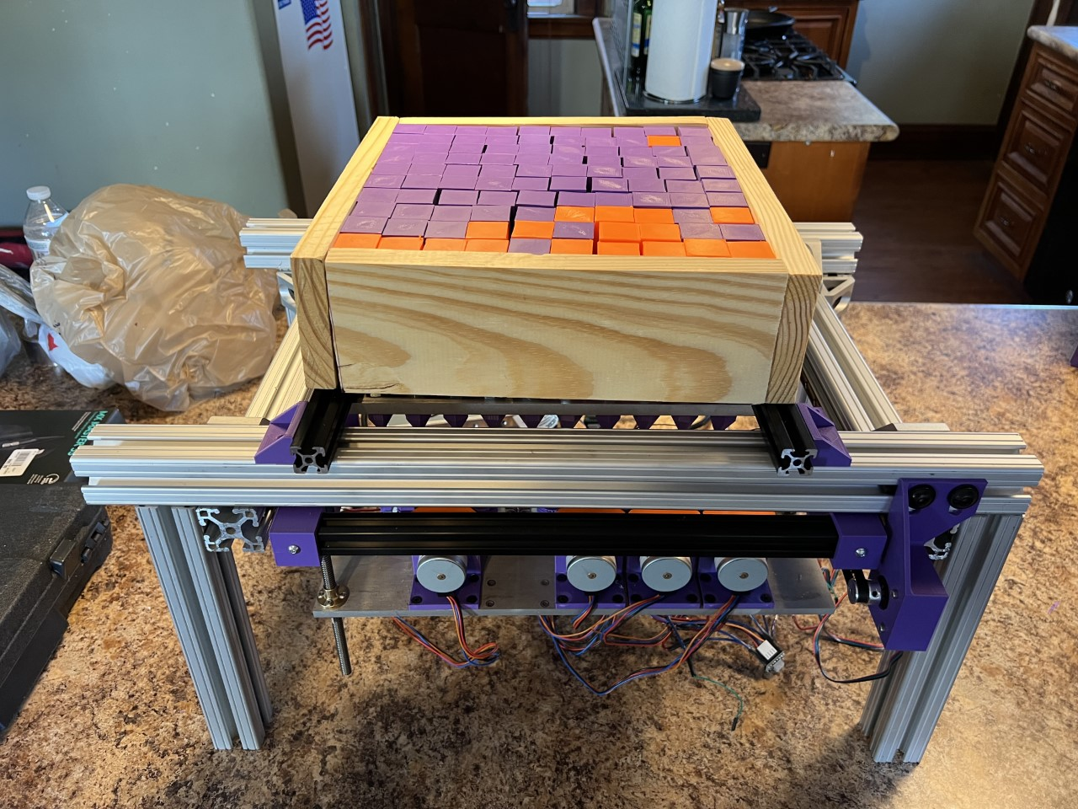
Prototype
2023 CEAS EXPO

Slide 13
Project Learnings
2023 CEAS EXPO
Possibilities for Future Work
Areas for Improvement
Set intermediate goals
Follow weekly meeting schedules
Factors for Success
Regular Advisor Meetings
Divide and Conquer Project Build
Preemptive Budgeting Prevents Over-Spending
Improve quality of components; more manufactured parts to replace improvisations
Develop enclosure to eliminate aluminum 80/20 and reduce weight
Upgrade to encoded motors for position reading
Eliminate loose wiring with custom circuit board and better management
Investigate alternative to 3D printed components
Integrate design into a physical table

Slide 14
Thank you

